Slide 1
BROWSER HISTORY SIMULATOR
TEAM MEMBERS
D.Charishma-25A31A0570
Ch.rama devi-25A31A0569
K.manoj-25A31A05AK
Ch.revanth sai-25A31A05AE

Slide 2
INTRODUCTION
Browser History Simulator
The Browser History Simulator is a console-based application developed using C++ that mimics the basic functionality of a web browser’s navigation system. This project uses the stack data structure to manage browsing history efficiently. It allows users to visit new web pages, navigate backward and forward, view the current page, and clear browsing history. Although it does not load real web pages, it demonstrates how browser navigation works internally using data structures.

Slide 3
DATA STRUCTURE
Stack Data Structure (LIFO - Last In First Out)
The project uses two stacks:
Back Stack → stores previously visited pages
Forward Stack → stores forward pages
Why Stack?
Supports efficient Back and Forward operations
Follows LIFO principle (last visited page is accessed first)
Working:
Visit → push into backStack
Back → move page to forwardStack
Forward → move page back to backStack

Slide 4
ALGORITHM
Initialize backStack, forwardStack, and currentPage
Display menu and take user input
If user selects:
Visit → Push currentPage to backStack, update currentPage, clear forwardStack
Back → Move currentPage to forwardStack, update from backStack
Forward → Move currentPage to backStack, update from forwardStack
Clear History → Empty both stacks
Display current page or history when required
Repeat until user exits

Slide 5
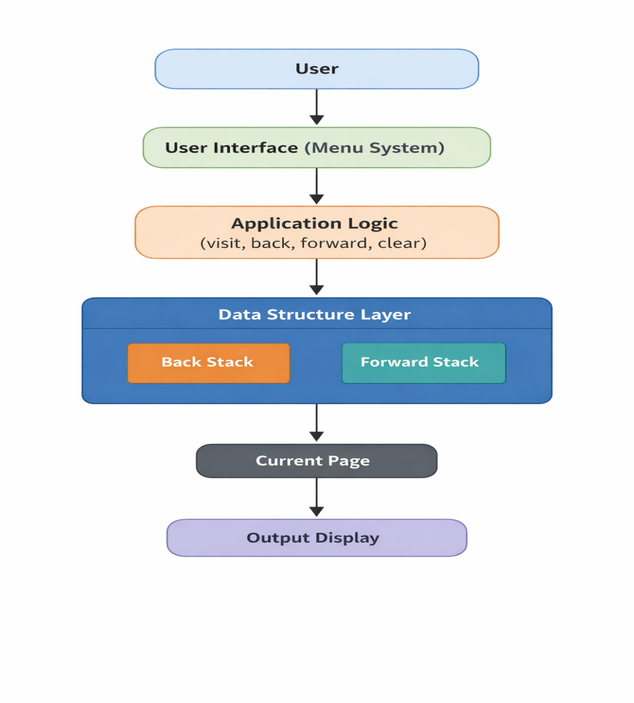
SYSTEM DIAGRAM

Slide 6
CODE
stack<string> backStack, forwardStack; string currentPage; void visit(string url) { backStack.push(currentPage); currentPage = url; while (!forwardStack.empty()) forwardStack.pop(); } void back() { if (!backStack.empty()) { forwardStack.push(currentPage); currentPage = backStack.top(); backStack.pop(); } }

Slide 7
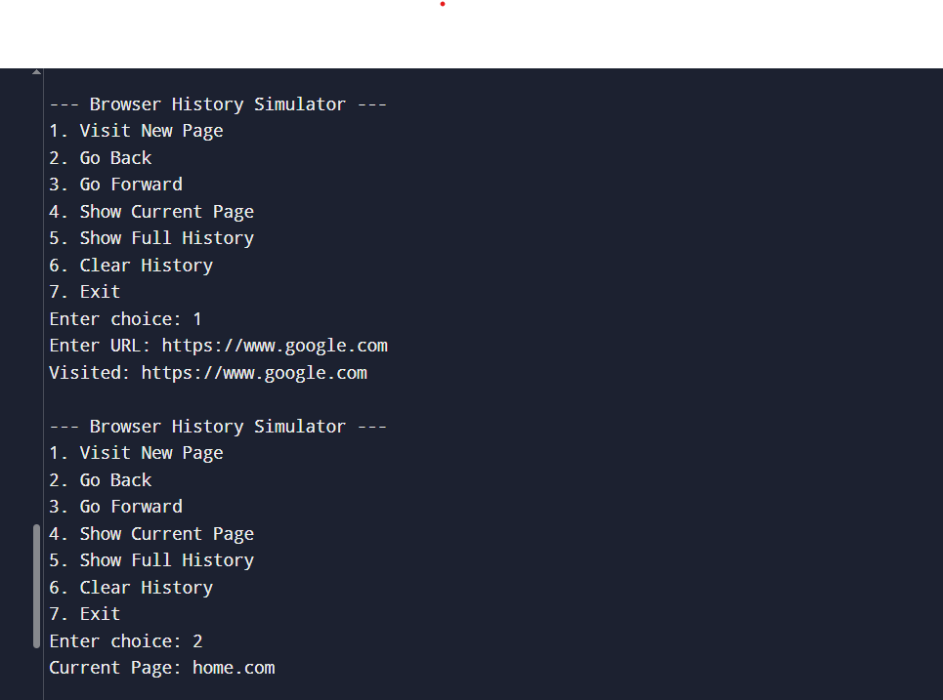
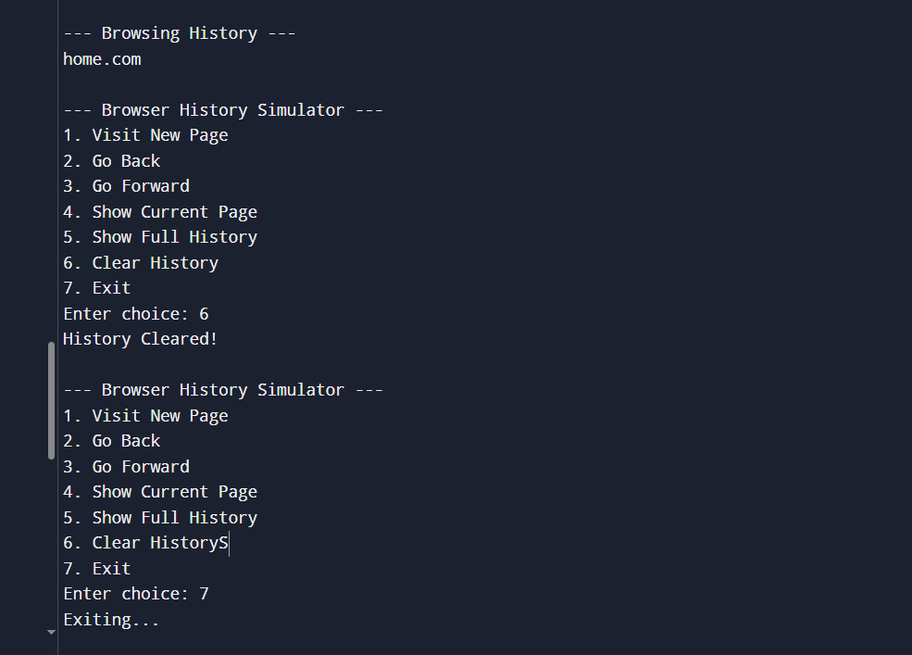
OUTPUT

Slide 8
CONCLUSION
The Browser History Simulator successfully demonstrates how stacks can be used to manage browser navigation efficiently. It provides a practical understanding of data structures and their real-world applications. The project enhances problem-solving skills and shows how simple concepts like stacks can be used to simulate complex systems such as web browsers. It can be further improved by adding graphical interfaces and real-time browser integration.

Slide 9
THANK YOU

